Slide 1

The Relevance of Philadelphia in our modern-day society
By Carlos Lopez

Slide 2


What’s it about?
Andrew Beckett played by Tom Hanks gets fired from his job as a lawyer.
He sues the company for firing him based on his disease and sexual orientation
Joe Miller played by Denzel Washington reluctantly takes his case
They both become good friends by the end
IMDb Philadelphia

Slide 3

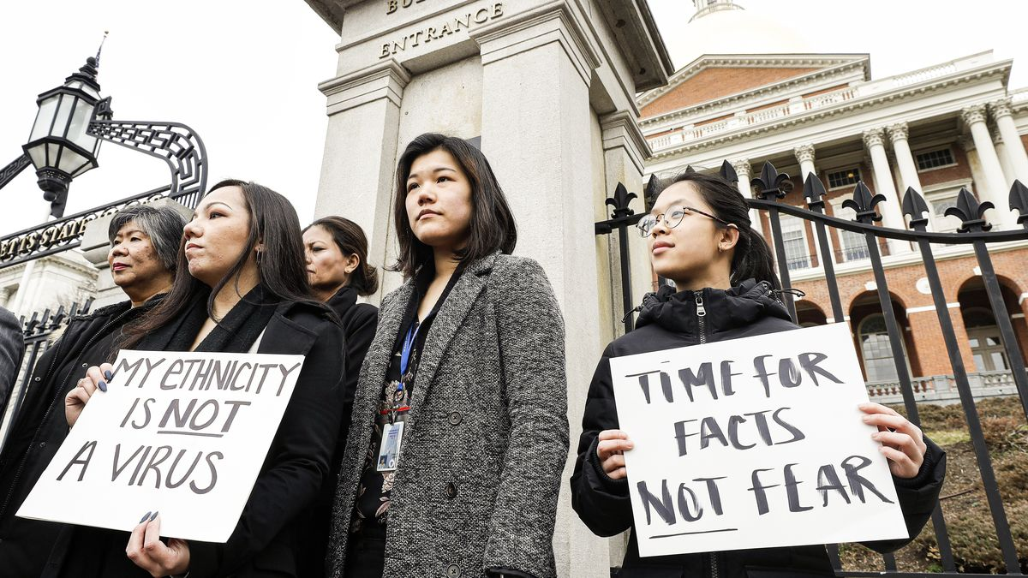
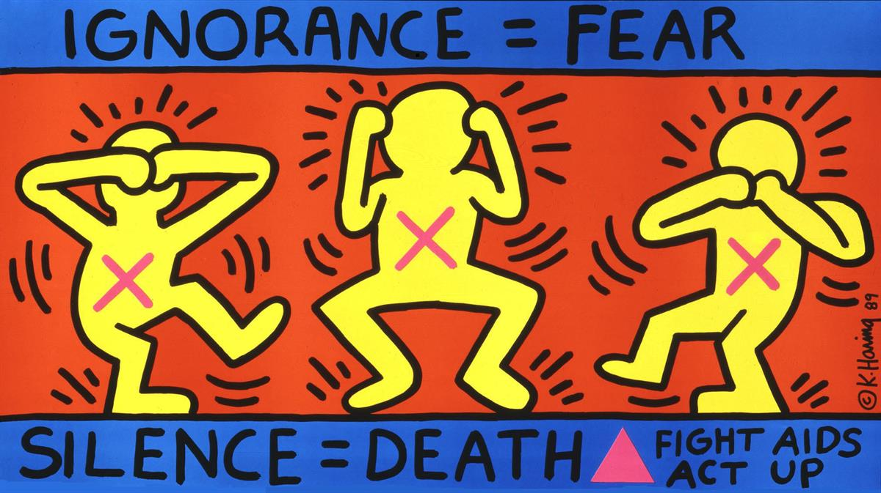
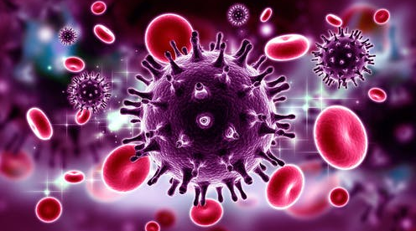
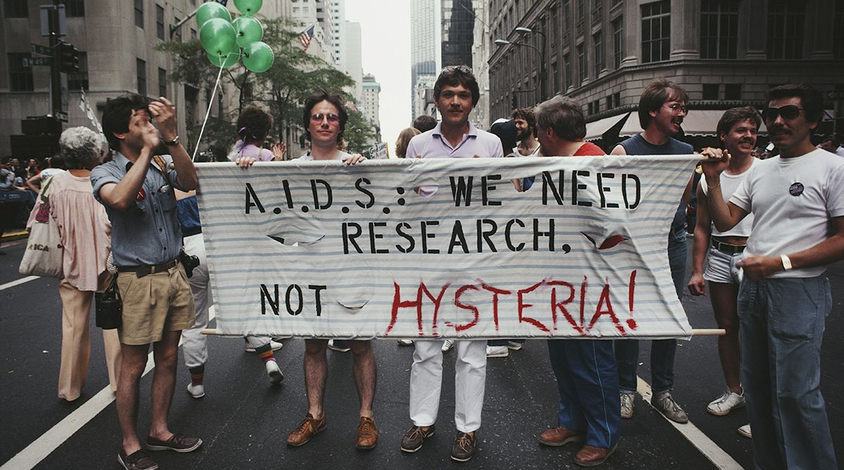
The Conversation Four Big Insights into HIV/AIDS that Provide Hope of Finding a Vaccine
Vox How the pandemic is triggering racist attacks
WHO. Why the HIV Pandemic Is Not Over
BBC News Coronavirus: Live News Coverage
Metro Powerful images from HIV epidemic protests in the 1980s and 1990s

Slide 4
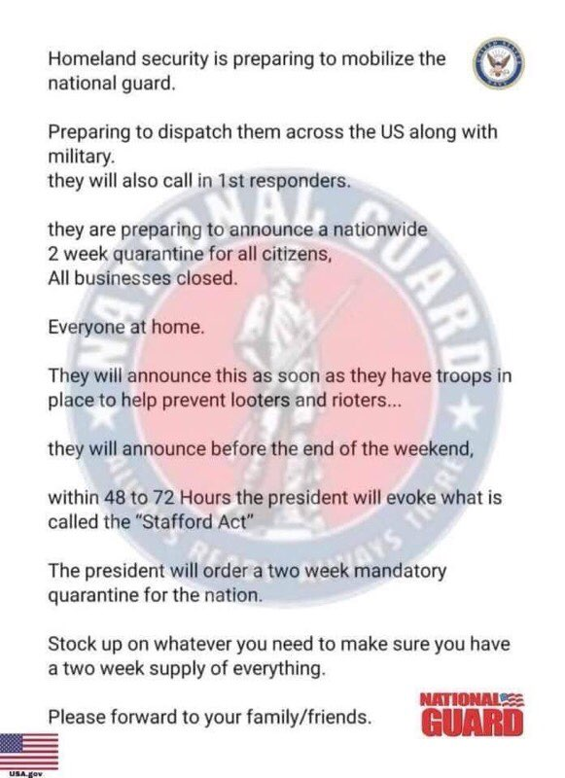
KRQE News National Guard Warns about Fraudulent Social Media Post.

Slide 5


KRQE News National Guard Warns about Fraudulent Social Media Post.
Mirror Coronavirus: Stampede at Aldi store as panicked shoppers rush to buy toilet paper
Washington Post Long lines, low supplies: Coronavirus chaos sends shoppers into panic-buying mode

Slide 6
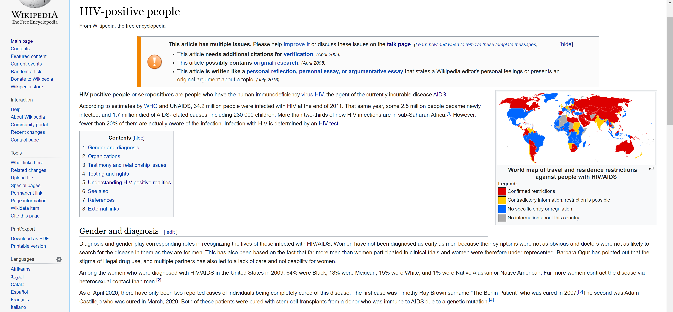

Slide 8
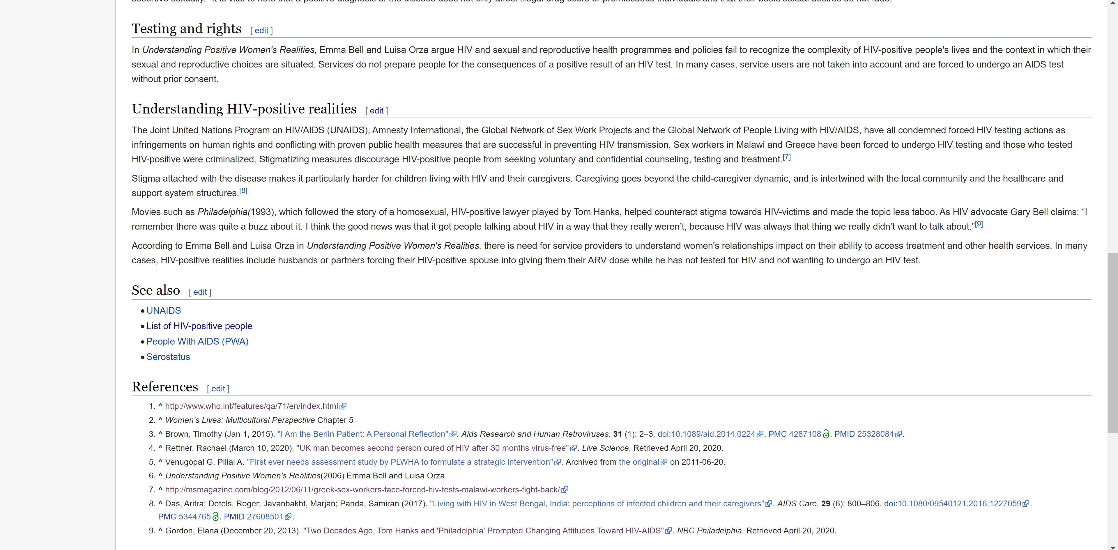

Slide 12

Bibliography
“Coronavirus: Live BBC News Coverage.” BBC News, BBC, 27 Apr. 2020, www.bbc.com/news/av/health-51849070/coronavirus-live-bbc-news-coverage?intlink_from_url=https://www.bbc.com/news/coronavirus&link_location=live-reporting-map.
Kim, Catherine. “‘They Just See That You're Asian and You Are Horrible’: How the Pandemic Is Triggering Racist Attacks.” Vox, Vox, 25 Mar. 2020, www.vox.com/identities/2020/3/25/21190655/trump-coronavirus-racist-asian-americans.
King, Lorraine. “Stampede at Aldi as Shoppers Rush to Buy Toilet Paper amid Coronavirus Crisis.” Mirror, 10 Mar. 2020, www.mirror.co.uk/news/world-news/coronavirus-stampede-aldi-store-panic-21665125.
Morley, Nicole. “Powerful Images from HIV Epidemic Protests in the 1980s and 1990s.” Metro, Metro.co.uk, 11 Dec. 2019, metro.co.uk/2016/11/23/powerful-images-from-hiv-epidemic-protests-in-the-1980s-and-1990s-6274896/.
“National Guard Warns about Fraudulent Social Media Post.” KRQE News 13, 27 Mar. 2020, www.krqe.com/health/coronavirus-new-mexico/national-guard-warns-about-fraudulent-social-media-post/.
Ndung, Thumbi. “Four Big Insights into HIV/AIDS That Provide Hope of Finding a Vaccine.” The Conversation, 18 Mar. 2020, theconversation.com/four-big-insights-into-hiv-aids-that-provide-hope-of-finding-a-vaccine-86736.
“Philadelphia.” IMDb, IMDb.com, 14 Jan. 1994, www.imdb.com/title/tt0107818/.
Taylor Telford, Abha Bhattarai. “Long Lines, Low Supplies: Coronavirus Chaos Sends Shoppers into Panic-Buying Mode.” The Washington Post, WP Company, 3 Mar. 2020, www.washingtonpost.com/business/2020/03/02/grocery-stores-coronavirus-panic-buying/.
Taylor Telford, Abha Bhattarai. “Long Lines, Low Supplies: Coronavirus Chaos Sends Shoppers into Panic-Buying Mode.” The Washington Post, WP Company, 3 Mar. 2020, www.washingtonpost.com/business/2020/03/02/grocery-stores-coronavirus-panic-buying/.
“Why the HIV Epidemic Is Not Over.” World Health Organization, World Health Organization, www.who.int/hiv-aids/latest-news-and-events/why-the-hiv-epidemic-is-not-over.

Slide 13
Fin

Slide 14
Fin
Questions?

